Slide 1
Although Easier, Is it Safe? Low Molecular Weight Heparin Anticoagulation in Young Children with Mechanical Prosthetic Valves
Colleen M Pater, MD, MS,^{1,2} Meredith Jenkins, PharmD, BCPPS,³ BreAnn Garr, PharmD, BCPS,³ Tanya Perry, DO,¹ Nicolas L Madsen, MD, MPH,^{1,2} David LS Morales, MD,^{1,2,4} ¹ – The Heart Institute, Cincinnati Children’s Hospital Medical Center, Cincinnati, OH ² – Department of Pediatrics, University of Cincinnati College of Medicine, Cincinnati, OH ³ – Division of Pharmacy, Cincinnati Children’s Hospital Medical Center, Cincinnati, OH ⁴ – Department of Surgery, University of Cincinnati College of Medicine, Cincinnati, OH

Slide 2
Background
Anticoagulation in children with mechanical prosthetic valves lacks evidence-based recommendations
Children typically receive adult-based oral vitamin K antagonist (VKA) regimens extrapolated from adult guidelines
VKA anticoagulation in infants is challenging due to variable dose response rates, inconsistent dietary vitamin K, frequent intercurrent illnesses, and difficulty with lab monitoring
Low molecular weight heparin (LMWH) is often used as bridging therapy during initiation or temporary interruption of VKA treatment in both children and adults
LMWH has been proposed as an alternative treatment in adults with mechanical prosthetic valves and VKA failure or intolerance
Notes:
Anticoagulation in children with mechanical prosthetic valves lacks evidence-based recommendations and children often receive adult-based oral vitamin K antagonists (VKA) regimens. However, this is particularly challenging in children. In adults, ow molecular weight heparin (LMWH) has been proposed as an alternative anticoagulation for patients with VKA failure or intolerance.

Slide 3
Case Summary
Successful use of LMWH as a primary anticoagulation strategy in four young children following mechanical valve replacement in whom satisfactory therapeutic anticoagulation could not be achieved with VKA
Definition of therapeutic anticoagulation:
INR 2.5 – 3.5 or LMWH level 0.5 – 1 IU/mL AND Percent of time therapeutic > 65%
Notes:
Here, we report the successful use of LMWH in young children after mechanical valve replacement iwhen therapeutic anticoagulation could not be achieved with VKA.
In accordance with national standards, satisfactory anticoagulation was defined as an INR of 2.5-3.5 for VKA therapy or LMWH level 0.5-1 IU/mL for LMWH therapy with a percent of time therapeutic greater than 65%.

Slide 4
Cases
Notes:
From 2016-2019, four pediatric patients underwent surgical replacement of systemic atrioventricular valves with mechanical prostheses The average age at valve replacement was 6.7 months. All patients were initially trialed on VKA therapy. In these patients, initial VKA therapy lasted an average 63 days with an average of 22% of time in therapeutic rang with 0.91 INRs per anticoagulation day, with the range seen in the following results slides. Due to unsatisfactory anticoagulation, all patients were transitioned to twice-daily LMWH therapy and subsequently achieved therapeutic levels an average 96% of days (range 95-99%) with 0.11 LMWH levels per anticoagulation day (range 0.11-0.24). Subsequently, two LMWH patients have transitioned back to VKA therapy with an average 67% TTR and 0.16 INRs per anticoagulation days. One patient is in the process of transitioning to VKA therapy. Including the fourth patient currently remaining on LMWH, the average LMWH duration was 12 months.

Slide 5
Cases
All patients also received low-dose aspirin
Two patients have successfully transitioned back to VKA therapy, third patient in process of transition
No major bleeding or thromboembolic events were associated with either anticoagulation strategy
One additional infant underwent mechanical valve replacement at 6 months of age during this time period, and was adequately anticoagulated with VKA only
Notes:
All patients additionally received low-dose aspirin. Two patients have successfully transitioned back to VKA therapy. There were no major bleeding or thromboembolic events. Of note, during this time period, one additional infant underwent mechanical valve replacement at 6 months of age and was adequately anticoagulated with VKA only.

Slide 6
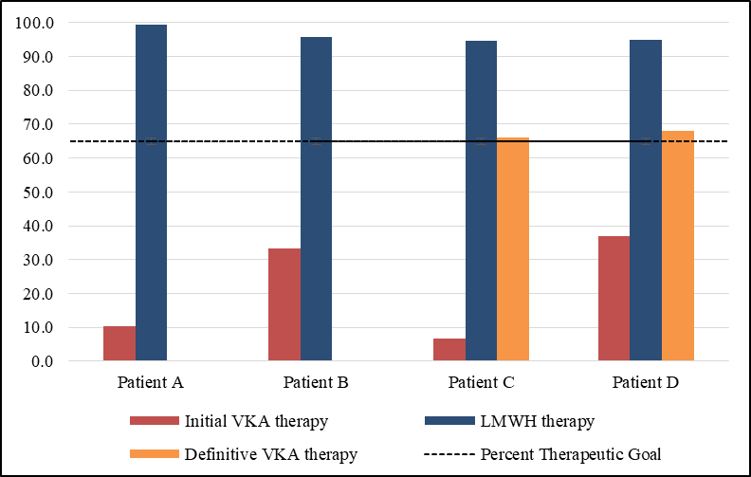
Results
Percent of Time Therapeutic on Anticoagulation
Notes:
Initial VKA therapy achieved an average of 22% of time in therapeutic range. Due to unsatisfactory anticoagulation, all patients were transitioned to twice-daily LMWH therapy and subsequently achieved therapeutic levels an average 96% of days (range 95-99%). Subsequently, two LMWH patients have transitioned back to VKA therapy with an average 67% TTR. One patient is in the process of transitioning to VKA therapy.

Slide 7
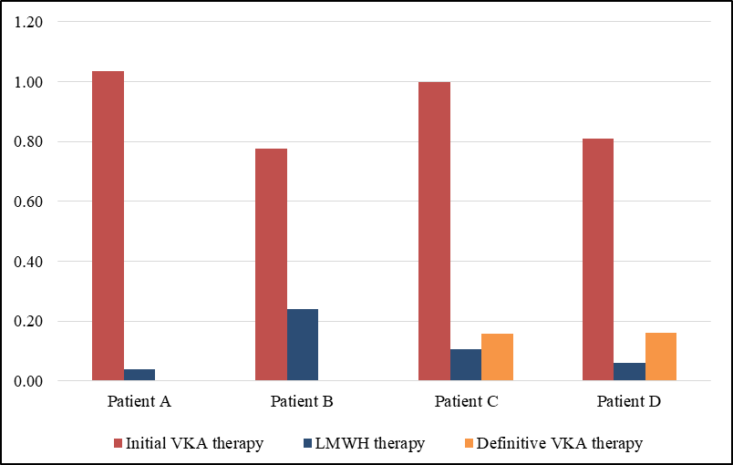
Results
Number of Monitoring Labs per Anticoagulation Day
Notes:
Initial VKA therapy required an average of 0.91 INRs per anticoagulation day. Following transition to LMWH therapy, patients achieved therapeutic levels with 0.11 LMWH levels per anticoagulation day (range 0.11-0.24). The two patients that have transitioned back to VKA therapy have an average 0.16 INRs per anticoagulation days.

Slide 8
Conclusions
On LMWH, these four patients reliably achieved therapeutic anticoagulation goals with less frequent monitoring labs than VKA therapy and without evidence of adverse event
Further collaborative investigation is needed to establish the efficacy and safety of a LMWH anticoagulation strategy in young children with mechanical valve prostheses
LMWH may be a safe alternative therapy to achieve satisfactory anticoagulation chronically or until VKA treatment is more likely to be successful

Slide 9
Acknowledgements
Anticoagulation outpatient team (N. Nelson, J. Ciambarella)
Patients and families of the Acute Care Cardiology Unit
The authors have no relevant disclosures.

