Slide 1
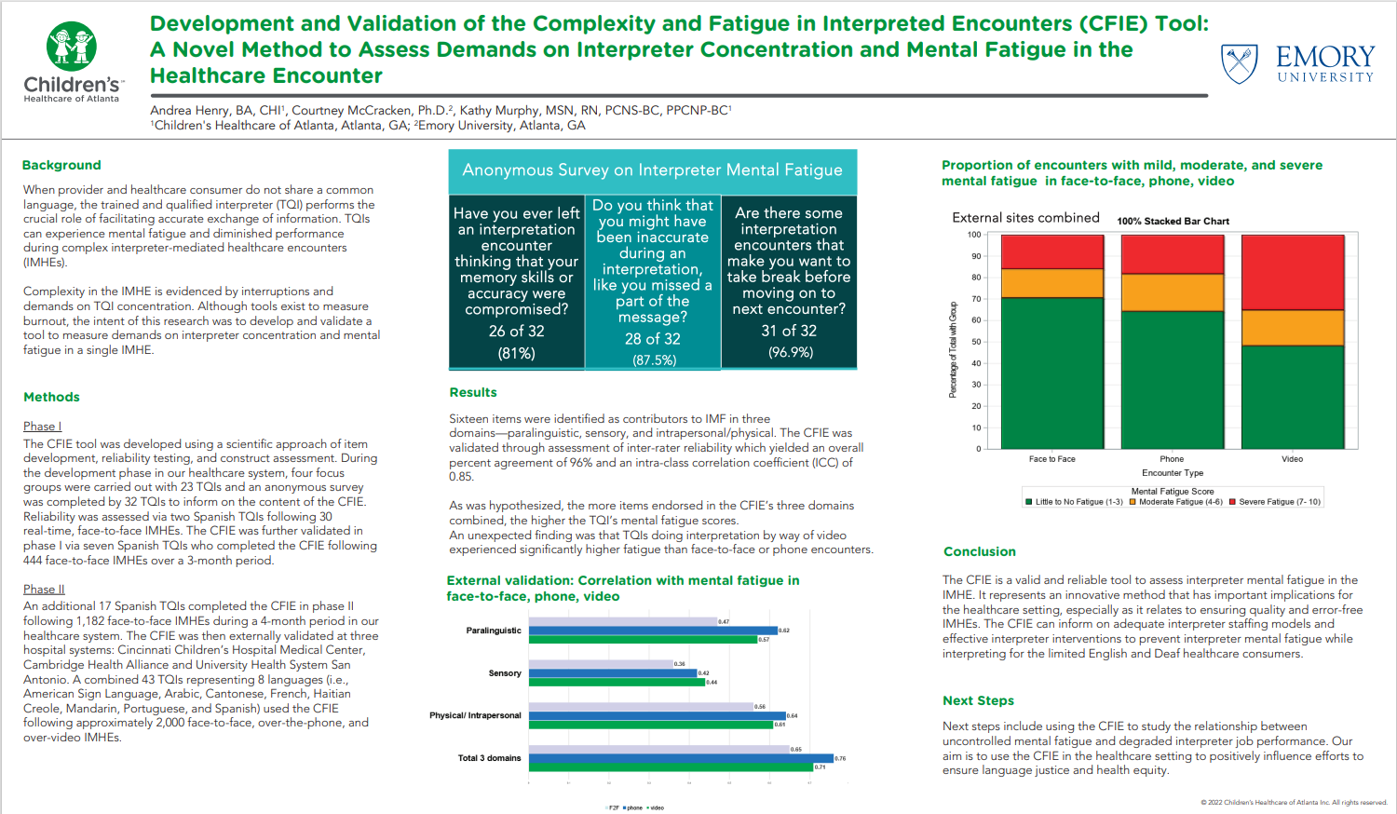
Notes:
What lessons have you learned? That tool development and validation requires patience, persistence, and a roundtable of interdisciplinary experts.
How will patient care outcomes or clinical practice be advanced by your results?
Our work can improve staffing models and working conditions for interpreters, which in turn, can improve their performance and prevent fatigue-related errors.
Future research, future application
What next steps do you envision?

