Slide 1
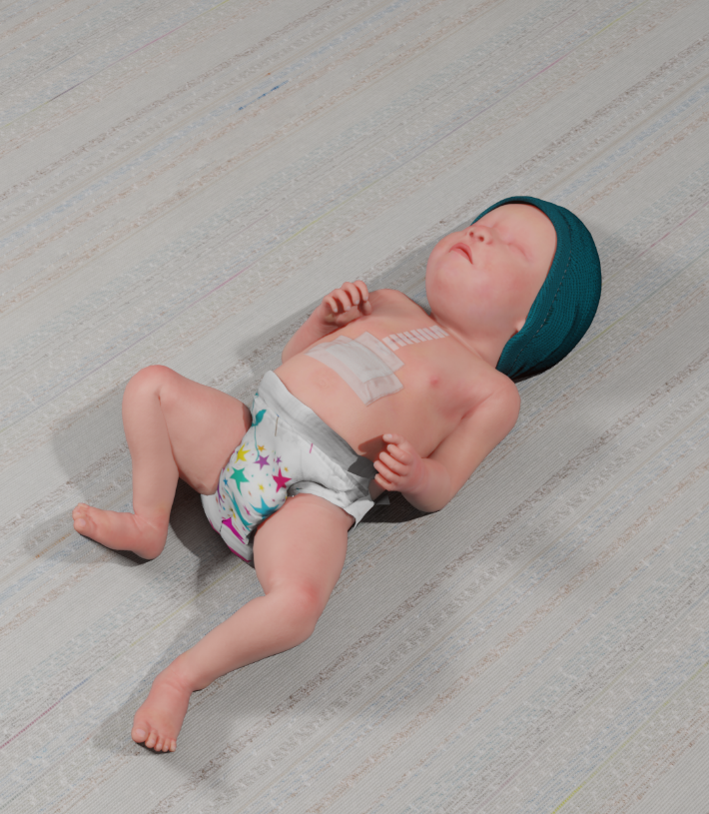
Parent Discharge Education & Readiness for the Transition to Home after Congenital Heart Surgery
Michael E Kim, DO; Nadine A Kasparian, PhD; Huaiyu Zang, PhD; Colleen Pater, MD; Meghan Chelbowski, MD; Amy Florez, APRN; David L.S. Morales, MD; Nicolas L. Madsen, MD; and Ryan A Moore, MD MSc
Background
Optimal inpatient care & discharge readiness is associated with favorable outcomes including reduction in hospital readmissions & increased medication adherence in the adult medical-surgical population (1,2) Discharge readiness research within the complex medical pediatric population has been limited to needs assessments & directed towards streamlining the discharge education process Congenital heart disease (CHD) populations, especially interstage/single ventricle, are at high risk for significant morbidity & mortality (3) We sought to describe our institutions current discharge processes & parent’s discharge readiness within the post-surgical population We hypothesize that families who report “lower scores of discharge readiness” would include younger patients of more vulnerable surgical categories (high STAT, interstage) & lower socioeconomic status (SES)
Results and Analysis
Results and Analysis
Table 1. Parent and patient characteristics
Patient Characteristics | Participants (n=128)
Age at surgery (days), median (IQR) | 168 (16.5, 1352.8)
Cardiac Lesion, n (%)
ASD or VSD | 11 (8.9%)
AVSD | 14 (11%)
Transposition of the Great Arteries (TGA) | 9 (7.3%)
Tetralogy of Fallot (TOF) | 16 (13%)
Hypoplastic Left Heart Syndrome (HLHS) | 20 (16%)
Tricuspid Atresia (TA) | 2 (1.6%)
Pulmonary Atresia (PA) | 1 (0.8%)
Total anomalous pulmonary venous return (TAPVR) | 1 (0.8%)
Coarctation of the aorta | 16 (13%)
Truncus Arteriosus | 2 (1.5%)
Double Outlet Right Ventricle (DORV) | 6 (4.8%)
Other complex heart disease | 26 (20.3%)
Comorbidities**, n (%) | 80 (62%)
First cardiac surgery, n (%) | 83 (65%)
STAT category, n (%)
1 | 27 (21%)
2 | 36 (28%)
3 | 24 (19%)
4 | 29 (23%)
5 | 12 (9.4%)
Tube feeds at home, n (%) | 66 (52%)
Home oxygen, n (%) | 24 (19%)
IV medications at home, n (%) | 2 (1.6%)
Arrhythmia medications for home, n (%) | 5 (3.9%)
Total number of medications, median (IQR) | 4 (2, 6)
**Comorbidities include some of the following: Trisomy 21, 22q11 deletion syndrome, heterotaxy syndrome, tethered cord syndrome, obstructive sleep apnea (OSA), CHARGE syndrome, seizure disorder, arrhythmias (i.e. SVT, atrial tachycardia), prematurity
Table 3. Linear regression models examining for six predictors with mRHDS survey 1 scores. Note: CI, confidence interval; df, degree of freedom.
Table 4. Comparison of clinical engagement with SES clusters & age groups. Note: **number of clinic visits within 30 days post-discharge; ⁺one patient family was noted to have no documented clinic follow-up after discharge; ¹Chi-square test
 | Parent Characteristics | Participants (n=128)
Relation to Patient, n (%) | Mother | 116 (91%)
 | Father | 11 (8.6%)
 | Legal Guardian | 1 (0.8%)
 | Age, median (IQR) | 31 (27, 35)
Race, n (%) | Asian | 2 (1.6%)
 | Black | 11 (8.6%)
 | Hispanic or Latino | 4 (3.1%)
 | White | 106 (83%)
 | Other | 7 (5.5%)
Ethnicity, n (%) | Hispanic, Latino or Spanish origin | 5 (3.9%)
 | Not Hispanic, Latino, or Spanish origin | 121 (95%)
 | Unknown | 2 (1.6%)
Gender, n (%) | Male | 11 (8.6%)
 | Female | 117 (91%)
Martial Status, n (%) | Single | 32 (25%)
 | Married | 73 (57%)
 | Other | 23 (18%)
 | Living with another adult at home, n (%) | 113 (88%)
Payer, n (%) | Public | 62 (48%)
 | Private | 65 (51%)
 | Self | 1 (0.8%)
Education, n (%) | Less than high school | 3 (2.3%)
 | Completed high school | 33 (26%)
 | Trade school or community college | 29 (23%)
 | Undergraduate degree | 37 (29%)
 | Graduate degree | 26 (20%)
Socioeconomic status (Hollingshead Index), n (%) | Professional | 58 (45%)
 | Minor professional | 23 (18%)
 | Skilled worker | 19 (15%)
 | Semi-skilled worker | 17 (13%)
 | Menial worker | 11(8.6%)
 | Model 1 | Model 2
 | Coefficient (95% CI, p-value) | Coefficient (95% CI, p-value)
Parent age | -0.03 (-0.06 to 0.00, p=0.097) | -0.03 (-0.06 to 0.01, p=0.107)
Patient age | 0.22 (-0.30 to 0.75, p=0.405) | 0.16 (-0.42 to 0.75, p=0.580)
(>=1 yr old vs. < 1 yr old)
SES (4-5 vs. 1-3) | -0.04 (-0.46 to 0.37, p=0.834) | -0.02 (-0.43 to 0.39, p=0.916)
First surgery (yes vs. no) | -0.26 (-0.72 to 0.20, p=0.267) | 0.24 (-0.22 to 0.69, p=0.307)
STAT category (3-5 vs. 1-2) | 0.14 (-0.26 to 0.55, p=0.486) | 0.12 (-0.27 to 0.52, p=0.540)
Interstage (yes vs. no) | -0.20 (-0.89 to 0.48, p=0.555)
Tube feeds (yes vs. no) |  | -0.10 (-0.55 to 0.35, p=0.660)
F-statisics (df, p-value) | 0.883 (df = 6, 121, p= 0.510) | 0.856 (df = 6, 121, p = 0.529)
R square | 0.042 | 0.041
Adjusted R square | -0.006 | -0.007
 |  | Overall, n=128 | SES 1-3 | SES 4-5 | p-value¹ | Interstage | Infants (non-interstage) | Children | p-value¹
Phone calls | 0 to 1 calls | 85 (66%) | 29 (62%) | 56 (69%) |  | 5 (42%) | 44 (66%) | 36 (73%)
 | 2 or more calls | 43 (34%) | 18 (38%) | 25 (31%) | 0.5 | 7 (58%) | 23 (34%) | 13 (27%) | 0.1
Clinic visits | 1 visit | 71 (56%) | 26 (57%) | 45 (56%) |  | 1 (8.3%) | 42 (64%) | 28 (57%)
 | 2 or more visits | 56 (44%) | 20 (43%) | 36 (44%) | >0.9 | 11 (92%) | 24 (36%) | 21 (43%) | 0.002
ED visits | 0 | 100 (78%) | 31 (66%) | 69 (85%) |  | 7 (58%) | 49 (73%) | 44 (90%)
 | 1 or more | 28 (22%) | 16 (34%) | 12 (15%) | 0.02 | 5 (42%) | 18 (27%) | 5 (10%) | 0.02
Hospital readmissions | 0 | 101 (79%) | 32 (68%) | 69 (85%) |  | 4 (33%) | 53 (79%) | 44 (90%)
 | 1 or more | 27 (21%) | 15 (32%) | 12 (15%) | 0.04 | 8 (67%) | 14 (21%) | 5 (10%) | <0.001
Methods
Prospective study at a large pediatric tertiary referral center including patient families whose children underwent CHD surgery from April to December 2021 Parents & caregivers were approached within 24 hours prior to discharge; consenting families participated in filling out the modified Readiness for Hospital Discharge Scale (mRHDS), a validated instrument to measure discharge readiness (4) Surveys were administered at 3 time-points: 1) day of discharge, 2) one week post-discharge, 3) one month post-discharge Surveys were completed verbally with a research team member or occasionally used a tablet only at time of discharge Primary outcome was parent/caregiver discharge readiness via mRHDS score mRHDS score is broken down into 5 domains: 1) Parent Personal Status, 2) Child Personal Status, 3) Knowledge, 4) Coping Ability, 5) Expected Support Scores were calculated with the median value & broken into 4 categories: 1) Very High (9-10), High (8-8.9), Moderate (7-7.9), Low (<7) An additional domain was created for this study: 6) Cardiac Care Knowledge (of note, this was not included in the mRHDS score) A total of 199 eligible families were identified; 54 families were missed for consent 128 families consented to the study & completed mRHDS survey 1; 17 families refused 115 families completed survey 2 86 families completed survey 3 Survey data from time-points 2 and 3 will be presented in a future study
Conclusions
The mRHDS scores were overall ‘High’ to ‘Very High’ across group categories The mRHDS was not predictive in clinical engagement for families Highest risk populations with respect to clinical engagement remain those of the interstage population, younger patients, and lower SES There is a considerable gap when equating mRHDS discharge readiness scores & clinical engagement; this may be due to parents not knowing what to expect even with current discharge models creating a sense of confidence (based on high mRHDS scores) Future studies should look to expand studies to multiple centers & a wider range of diversity including non-English speaking families Future interventions can include novel educational modalities to help parents further conceptualize medical emergencies in patients, such as VR simulation (Image 1)
Image 1: Digital representation of a post-op CHD patient for future parent VR-based simulation
Table 2. Comparisons of mRHDS survey 1 scores with patient age (including interstage group), SES, STAT category, and first surgery. ¹Wilcoxon rank-sum test; ²Kruskal-Wallis test
 | Overall, n=128 | First surgery | Not first surgery | p-value¹ | SES 1-3 | SES 4-5 | p-value¹ | Interstage | Infants (non-interstage) | Children | p-value²
mRHDS score, median (IQR) | 8.6 (7.5, 9.2) | 8.7 (8.2, 9.2) | 8.4 (7.8, 9.0) | 0.04 | 8.8 (8.2, 9.2) | 8.5 (7.8, 9.0) | 0.2 | 9.0 (8.3, 9.4) | 8.6 (8.1, 9.1) | 8.5 (7.8, 9.0) | 0.2
Parent personal status | 8.4 | 8.5 | 8.1 | 0.3 | 8.8 | 8.4 | 0.3 | 8.8 | 8.4 | 8.2 | 0.02
Child personal status | 7.2 | 7.4 | 6.6 | 0.03 | 7.8 | 6.8 | 0.01 | 7.5 | 7.4 | 6.4 | 0.7
Knowledge | 9 | 9 | 9.2 | 0.5 | 9 | 9.1 | 0.6 | 9.3 | 9 | 9.2 | 0.3
Coping ability | 9.7 | 9.7 | 10 | 0.8 | 10 | 9.7 | 0.04 | 10 | 9.7 | 10 | 0.6
Expected support | 9.8 | 10 | 9 | 0.02 | 9.8 | 9.5 | 0.8 | 10 | 9.8 | 9.5 | 0.6
Cardiac care knowledge | 9.3 | 9 | 9.3 | 0.2 | 9 | 9.3 | 0.04 | 8.8 | 9 | 9.3 | 0.2
References
Bell, C.M., et al., Impact of patient-centered discharge tools: A systematic review. Journal of Hospital Medicine, 2017. 12(2). Mixon, A.S., et al., Preparedness for hospital discharge and prediction of readmission. Journal of Hospital Medicine, 2016. 11(9): p. 603-609. Marino, B.S., et al., Quality-of-life concerns differ among patients, parents, and medical providers in children and adolescents with congenital and acquired heart disease. Pediatrics, 2009. 123(4): p. e708-15 Weiss, M., et al., Readiness for Discharge in Parents of Hospitalized Children. Journal of Pediatric Nursing, 2008. 23(4): p. 282-295. The presenters have no disclosures or conflicts of interest to share for this study

