Slide 1
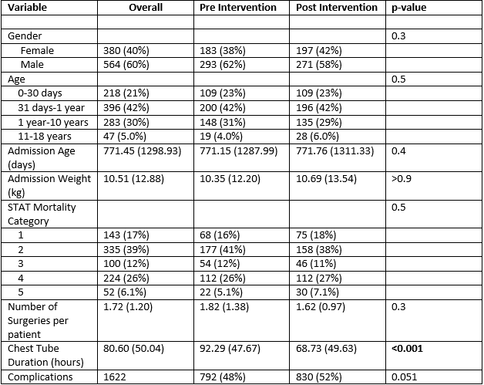
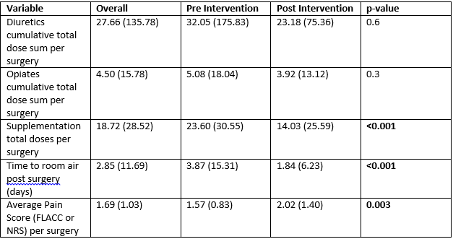
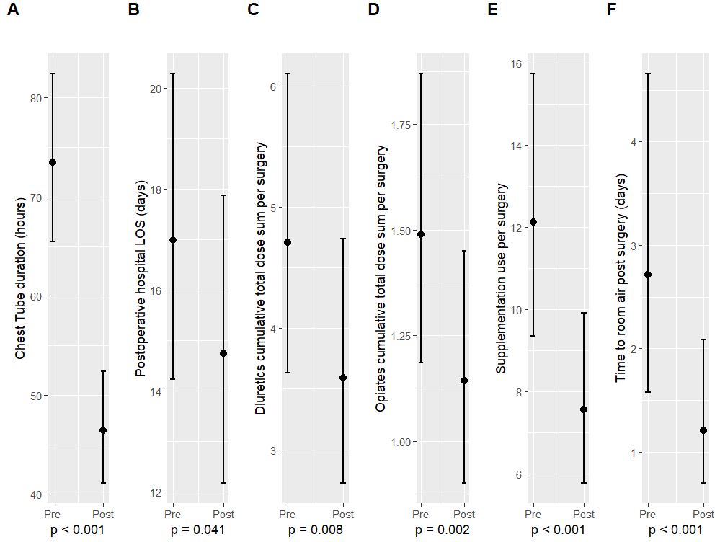
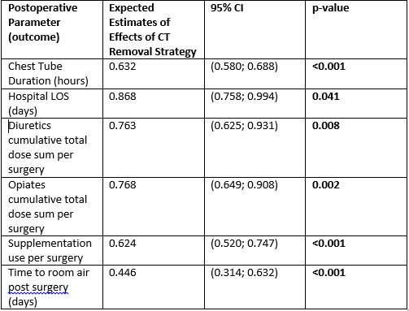
Reduction in Medical Intervention and Resource Utilization Following Introduction of an Early Chest Tube Removal Strategy in Post-Operative Cardiothoracic Surgeries
Tom Valikodath, MD¹; Nicolas Madsen, MD, MPH²; Margaret Graupe, MS¹; Monica Dugan, APRN¹; Amanda Hoerst, APRN¹; Huaiyu Zang, Ph.D¹; Laurie Smith, MS¹; James Tweddell, MD¹; Colleen Pater MD, MS¹
¹ The Heart Institute, Cincinnati Children’s Hospital Medical Center, Cincinnati, Ohio, USA; ²The Heart Center, Children’s Medical Center Dallas, Dallas, TX, USA
Background
Chest tubes (CT) remove extracellular fluid following pediatric cardiothoracic surgery CTs contribute to postoperative pain, decreased ambulation and prolonged length of stay (LOS) -Multicenter quality improvement project for early CT removal decreased CT duration and hospital LOS Postoperative medical intervention, resource utilization and patient reported pain following implementation of an early CT removal have not been studied
Results: Demographics
Table 1: Demographics of Overall Cohort Pre and Post Intervention Groups
Results: Unadjusted Outcomes
Table 2: Unadjusted Medical Interventions, Resource Utilization, and Patient-Reported Pain
Aims
Assess for changes in post operative medical interventions, resource utilization (diuretic and supplement need, narcotic and oxygen use) and patient reported pain scores following implementation of an early CT removal strategy
Limitations
Retrospective single center study Potential for incomplete clinical outcomes collection and prescriber preference variability Excluded patients >18 years old Many variables that affect CT output not included in the study
Methods
Single-center retrospective review of all pediatric cardiothoracic patients -Baseline group: May 1, 2017-August 31, 2018 -Intervention group: May 1, 2017-December 31, 2019 Local early CT removal strategy targeted removal on post-operative day 1, regardless of volume of output, unless bloody or chylous Data extracted from electronic medical record, Pediatric Cardiac Critical Care Consortium (PC⁴) and Pediatric Acute Care Cardiology (PAC³) data registries and collected from date of CT insertion to 5 days after CT removal or patient discharge, whichever occurred first Patients subcategorized by age and surgical complexity Pearson chi square test and Wilcoxon rank-sum test used to assess for associations between categorical variables and continuous variables respectively Distinct mixed-effects gamma log link regression model used to analyze outcomes when adjusting for patient age, weight, and surgical complexity
Results: Adjusted Outcomes
Figure1/Table 3: Effect of Early CT Removal Strategy on Medical Interventions, Resource Utilization, and Patient-Reported Pain when Adjusted for Patient Age, Weight, and Surgical Complexity
Conclusions
Early CT removal strategy results in decreased CT duration and LOS for select patient groups Implementation of an early CT removal strategy is associated with decreased electrolyte supplementation, time to room air, and post-operative patient-reported pain When adjusting for patient age, weight, and surgical complexity, the effect of an early CT removal strategy on medical interventions, resource utilization and patient-reported pain is particularly pronounced
Disclosures
The authors have no financial or regulatory disclosures.

