Slide 1
[how to use this slide deck]
This slide deck is intended to provide information that may be helpful when presenting to administrators
There are 3 general sections: Introduction, Impact on Patient Care and Patients & Family experience, Opportunities for providers and member centers. There is a “resources needed” section at the end for reference.
As a first step, we encourage you to complete a stakeholder analysis and align this presentation with goals that are most important to your key stakeholders
  Shorten: We intentionally included a lot of information, and recommend that you edit it down to the most important to your administrators
  Add: Consider adding local data to compare with national data

Slide 2
The Value of PAC³ for Member Institutions
June 2021

Slide 3
Pediatric Acute Care Cardiology Collaborative
Vision: To improve cardiac acute care outcomes by fostering sustainable quality improvement initiatives and optimizing organizational partnerships
Mission: The mission of the Pediatric Acute Care Cardiology Collaborative is to improve cardiac acute care outcomes by focusing on quality, value, and experiences as appreciated by all stakeholders

Slide 4
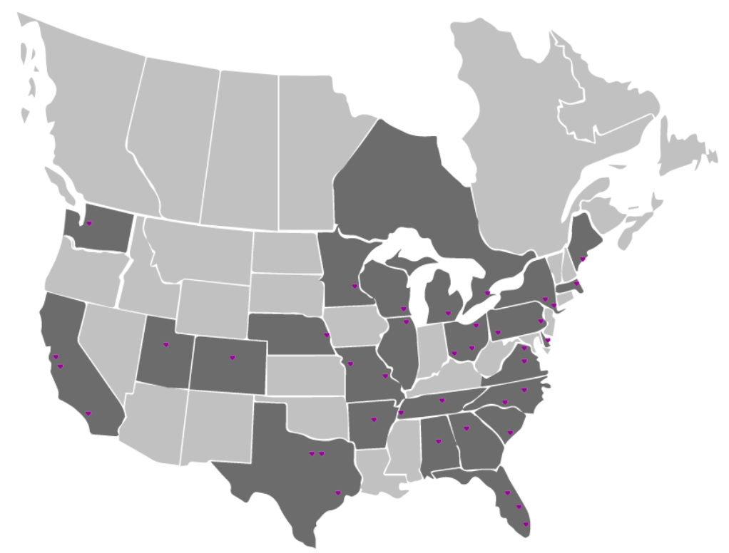
Who We Are
PAC³ Members 2020:
  41 Centers
  40 Centers were also PC4 members
We are made up of:
  Cardiologists
  Cardiac surgeons
  Advanced Practice Providers
  RNs
  Data champions
  Patients/families
See our up-to-date participants list at: pac3quality.org/participating-hospitals

Slide 5







Cardiac Networks United
Accelerating discovery and improvements in care through collaboration

Slide 6

Founding Member: Cardiac Networks United
Accelerating discovery and improvements in care through collaboration

Slide 7
Why Join PAC³
Only national collaborative and registry with focus on pediatric acute care cardiology
Benchmarking
Integration with other cardiac registries including STS and PC⁴ to get the full patient picture
Improved patient outcomes through local clinical improvement work
Participation in national quality improvement and research projects
      Opportunity to gain from network level QI work through sustain packages and Getting Started Toolkit for data entry start
Quality Improvement and Clinical Education
Opportunities for professional and career growth for participants through mentoring, collaboration, and networking
Patient and Family Engagement/Support
Point on U.S. News and World Report

Slide 8
Our Focus
collaborative
work
(with hospitals &
other networks)
research
quality improvement
Acute Care Cardiology Unit Patients and Data Registry

Slide 9
Impact on Patient Care and Patients & Family Experience

Slide 10
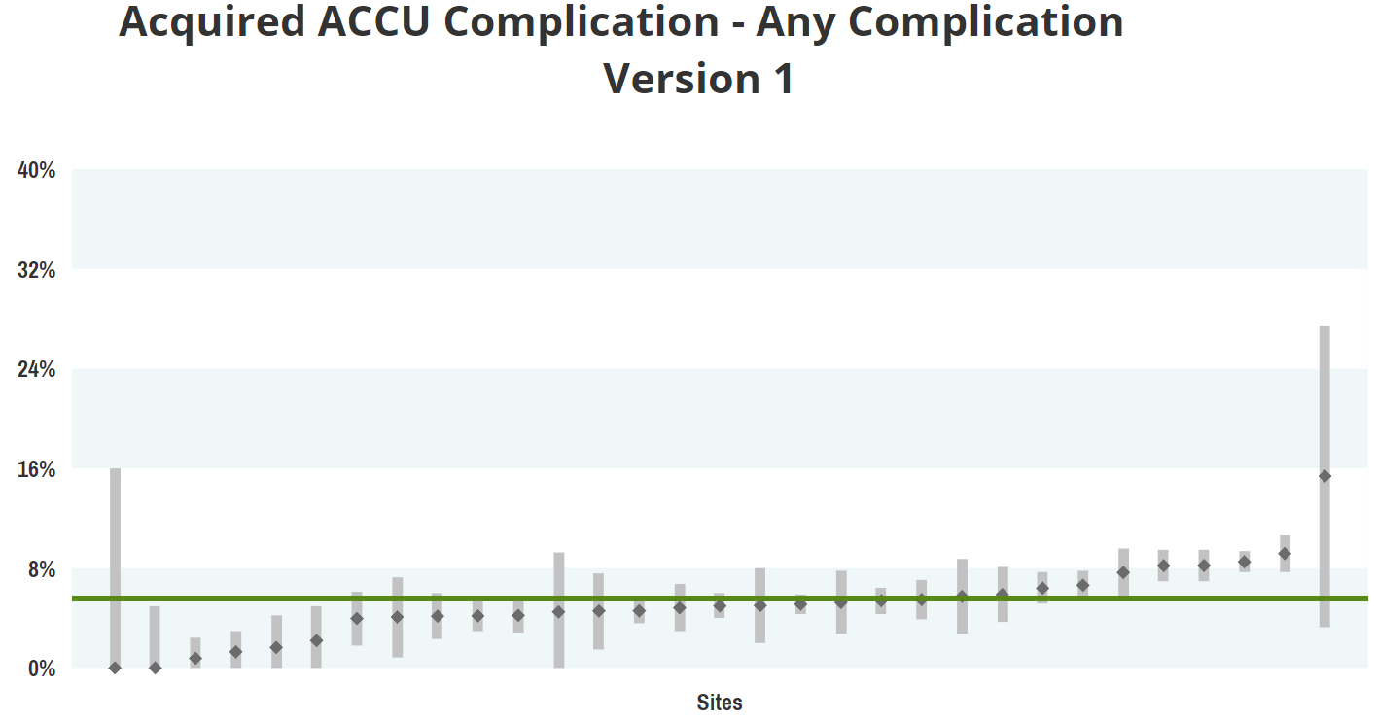
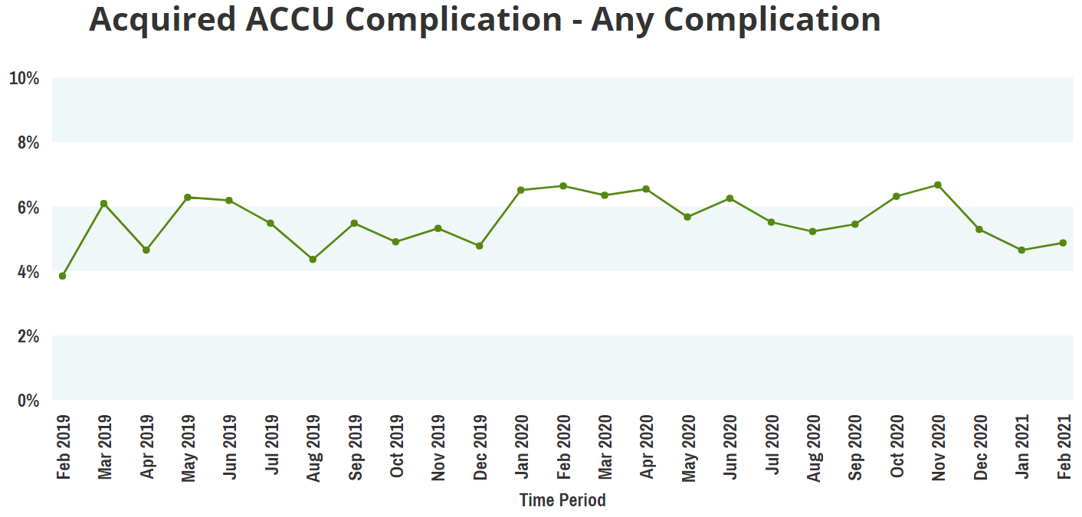
PAC³ Impacts Patient Care through Data
Real time access to data
  Compare data on length of stay, resource utilization, therapies, feeding, complications, and other variables with other centers
Clinical Champion unblinded access to hospital data
Compare variables across centers and over time

Slide 11
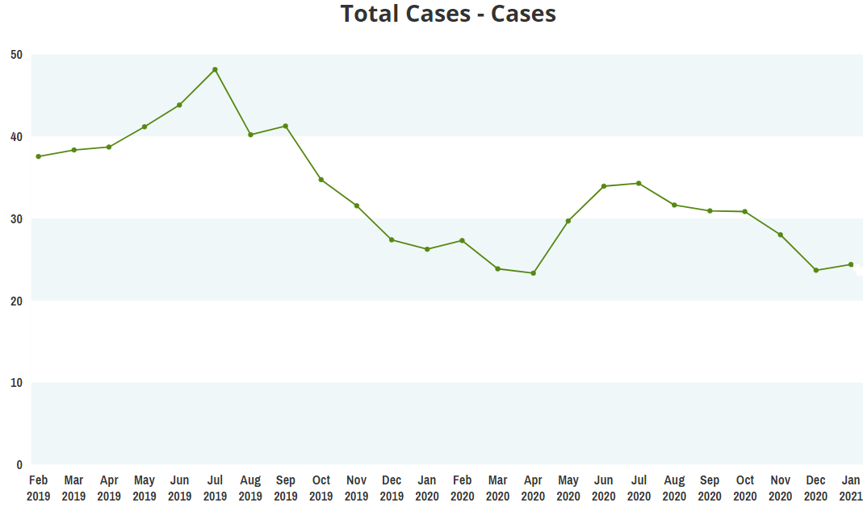
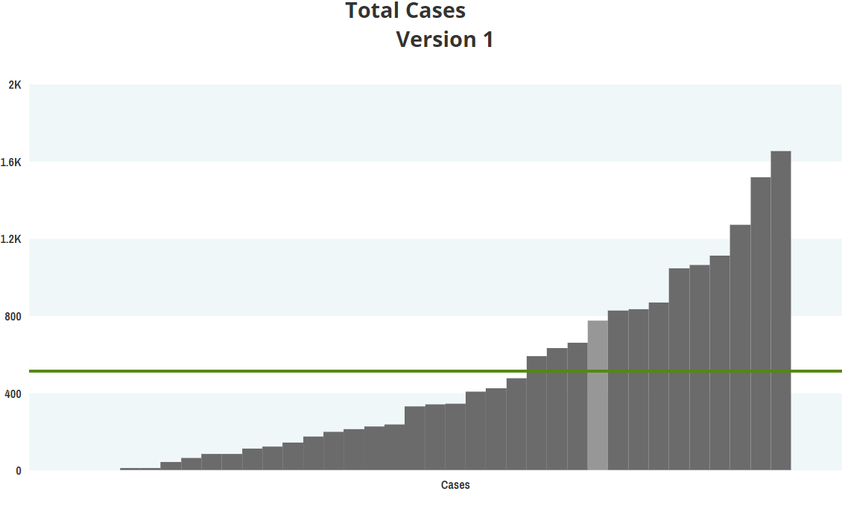
PAC³ Impacts Patient Care through Benchmarking
“Our collaboration with clinical data registries and their reporting platforms allow us to benchmark with other centers in near-real-time. Our center relies heavily on the PC4 and PAC³ reporting platform to track and trend data, and to identify opportunities for improvement. The ease-of-use, especially visualizing the data in run charts and bar charts is extremely valuable.” – PAC³ Member Center

Slide 12
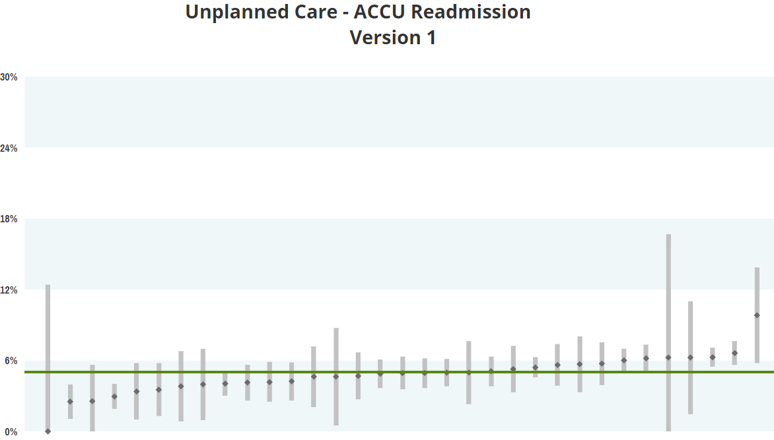
“PAC³ clinical data and benchmarking provided information for us to recognize how our readmission rate compared to other centers to further support our need for improvement in this area. PAC³ data will allow us to dive deeper into our readmissions to identify themes, specific patient populations, and causes which will help us direct our improvement interventions.
Participation in PAC³ collaborative has also provided our center with valuable education and tools to complete quality improvement initiatives that will help as we embark on reducing readmissions on our acute care floor.”
–PAC³ Member Center

Slide 13
Placeholder: Local Data
Notes:
Consider other places to add placeholder for local

Slide 14
PAC³ Supports Actionable Registry Data
Timely, accurate data is essential for use in local clinical and quality work as well as for collaborative research projects
Rigorous, four-tiered auditing process for all centers within 1 year after data entry start
The cost of data collection is the most significant of membership; PAC³ is leading a QI project aimed at improving systems around data collection to maximize efficiency
NOTE: Centers with a 1.0 FTE dedicated to data collection for every 1,000 inpatient encounters/year were most successful in achieving timely, accurate data reporting.

Slide 15
Four-tiered Audit Framework
local site and dcc audit
regional audit
Review PC4 audit status
Ensure all cases are submitted
Reliability of cases
Validity
Confirm that site has passed a PC4 Audit
PAC³-only centers: 1st audit will be individual
Send census data to DCC for comparison with cases entered into PAC³ registry
Lara to reconcile census with submitted data
Internal review
of cases
Centers report on internal reliability auditing quarterly
Ensure data is entered accurately
Takes place in-person or virtually
Data manager calculates scoring
Notes:
Sue present

Slide 16
PAC³ Supports Actionable Registry Data
The initial effort of this project was targeted at sites who were not regularly submitting data within 2 months of discharge
Within the year (and despite COVID) these centers increased the percentage of cases submitted within 2 months of discharge from 43% to 75%

Slide 17
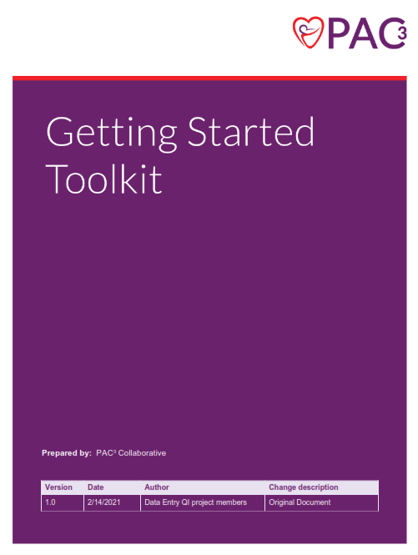
PAC³ Resources for Data Entry
The Getting Started Toolkit is available online and on SharePoint
Includes sections on:
  Expectations for the clinical champion, data champion & data team
  Building a patient identification report
  Chart abstraction for challenging fields
  Tracking patients
  Process for internal review of cases
  Maximizing partnerships with
  clinical teams

Slide 18
Placeholder: Local Timeliness Data

Slide 19
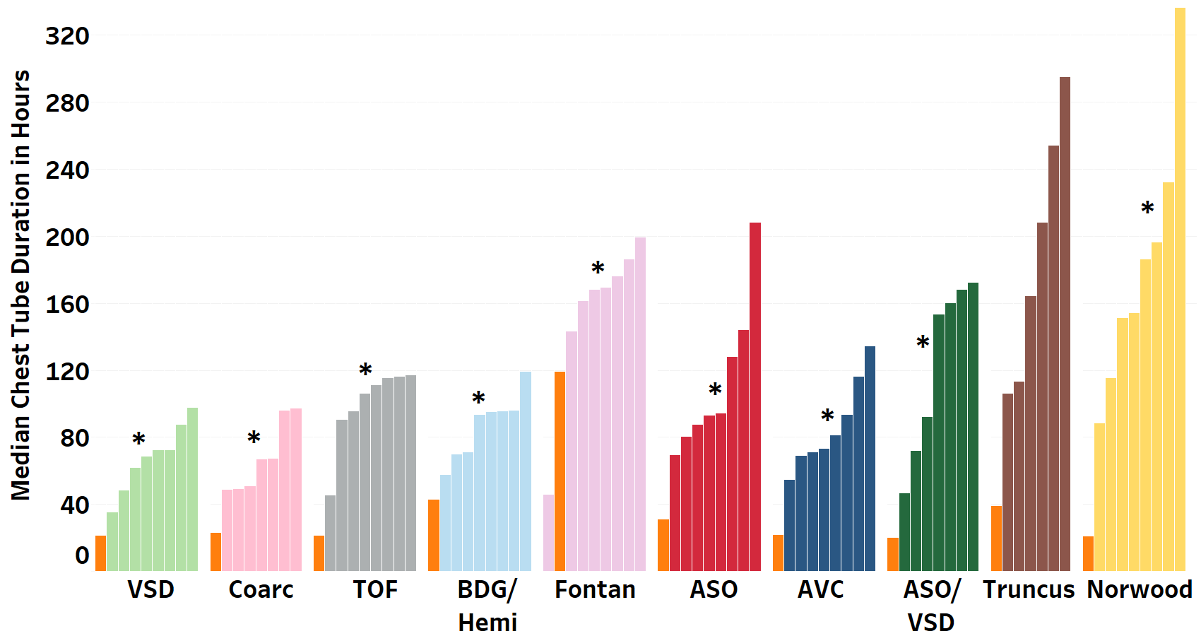
PAC³ Impacts Care through Quality Improvement
Chest tube duration reduction after cardiothoracic surgery
  Identified a model site and learned from it
  Pioneer cohort successfully decreased chest tube duration
  Spread to an additional 9 sites
  Developing a change package to allow all other centers to take on this project
Model site
*p<0.05 across sites

Slide 20
Data from the Chest Tube Duration Reduction QI project
Centers in the pioneer cohort reduced chest tube duration by >25% reduced length of stay from a mean of 11.4 days to 10.4 days in 2V STS benchmark surgeries

Slide 21
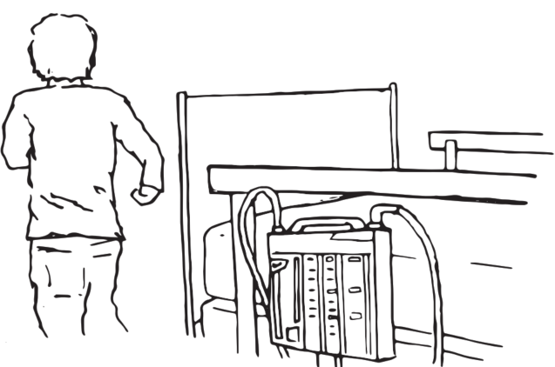
Quotes from Families on the Chest Tube Project
”We could tell it was so uncomfortable which meant he had to get pain meds consistently to alleviate the pain. The second the chest tube came out there was an instant change in our son’s behavior, and you could tell he was more comfortable. Short chest tube durations mean less time being uncomfortable, less time getting pain meds, a faster recovery process and hopefully shorter hospital stay.”
–Sameer, Dad of Dev
Getting them out was one step closer to my being able to hold him so I was glad to see them go!
–Corey, Mom of Noah
“Going forward, having a shorter chest tube duration means that there is the possibility that families of kids who have heart surgery can get back to their “normal” lives, which is always a good thing.”
–Mariel, Mom of Eli

Slide 22
Opportunities to Share and Learn from Other Sites
Sharing of ideas across hospitals at conferences and on project webinars
“All Teach, All Learn” conference sessions
    Centers are invited to present local projects and get feedback from the group
Self-organizing multi-site Quality Improvement projects
    PAC³ provides support for quality improvement projects when 3–5 centers want to get together to tackle the same problem

Slide 23
Placeholder: Local Impact of PAC³ on Quality Improvement

Slide 24
Opportunities for Providers and Member Centers

Slide 25
Educational Opportunities Provided by PAC³
Monthly Inpatient Education Series for the bedside provider
  See past recorded webinar talks at: pac3quality.org/education-series
Quality Improvement education
  On collaborative QI project webinars
  Through Institute for Healthcare Improvement (IHI) Open School licenses*
  Through LifeQI software licenses*
  Quality improvement education course (pilot phase)
APP orientation curriculum (in development)
*provided by Cardiac Networks United

Slide 26
Leadership Opportunities for All Levels of Provider
Opportunities to present at national conferences and in educational series
Authorship on publications
Committee membership and leadership roles
Project leads

Slide 27
Resources Needed

Slide 28
Resources & Contracting
Data Entry Personnel – data entry and travel for meetings
  Most successful sites in terms of data accuracy and timeliness have 1FTE per 1,000 acute care unit encounters/year
Non-PC⁴ sites: work with Michigan to get DUAs in place
IRB exemption/approval needed

Slide 29
Resources Needed
ArborMetrix (annual cost)
$12,500 for one registry (PAC³ or PC⁴)
$17,500 for both (PAC³ and PC⁴)
LUMEDX and CardioAccess
  Prefer to quote sites individually
  One time set up fee estimated to be $10–15K
  Annual maintenance fee estimated to be $3–6K
PAC³ fee
  $2K in FY2022

