Slide 1
The Value of PAC³ for Member Institutions
Revised January 2025

Slide 2
[how to use this slide deck]
This slide deck is intended to provide information that may be helpful when presenting to administrators
There are 3 general sections: Introduction, Impact on Patient Care and Patients & Family experience, Opportunities for providers and member centers. There is a “resources needed” section at the end for reference.
As a first step, we encourage you to complete a stakeholder analysis and align this presentation with goals that are most important to your key stakeholders
Shorten: We intentionally included a lot of information, and recommend that you edit it down to the most important to your administrators
Add: Consider adding local data to compare with national data

Slide 3
Introduction

Slide 4
Pediatric Acute Care Cardiology Collaborative
Our Mission: is to improve acute care cardiology outcomes by focusing on quality, research, value, and experiences as appreciated by all patients, loved ones, and care team members.
Our Focus:
Patients, Families, Advanced Practice Providers, Nurses, Data champions, Cardiologists, Cardiac surgeons, pharmacists, social workers, etc.

Slide 5
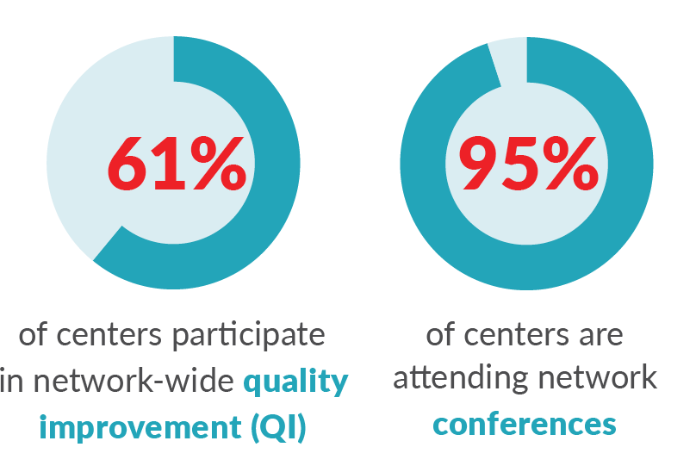
Who We Are
50
See our up-to-date participants list at: pac3quality.org/participating-hospitals

Slide 7
Why Join PAC³
Only national collaborative and registry with focus on pediatric acute care cardiology
Benchmarking
Integration with other cardiac registries including STS and PC⁴ to get the full patient picture
Improved patient outcomes through local clinical improvement work
Participation in national quality improvement and research projects
Quality Improvement and Clinical Education
Clinical Practice Guidelines
Opportunities for professional and career growth for participants through mentoring, collaboration, and networking
Patient and Family Engagement/Support
Point on U.S. News and World Report

Slide 8
Cardiac Networks United
Accelerating discovery and improvements in care through collaboration

Slide 9
Impact on Patient Care and Patients & Family Experience

Slide 10
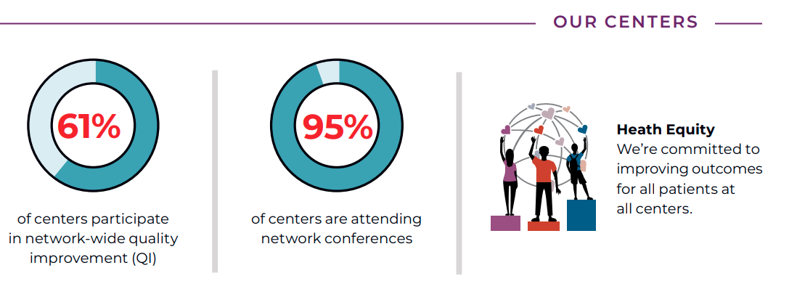
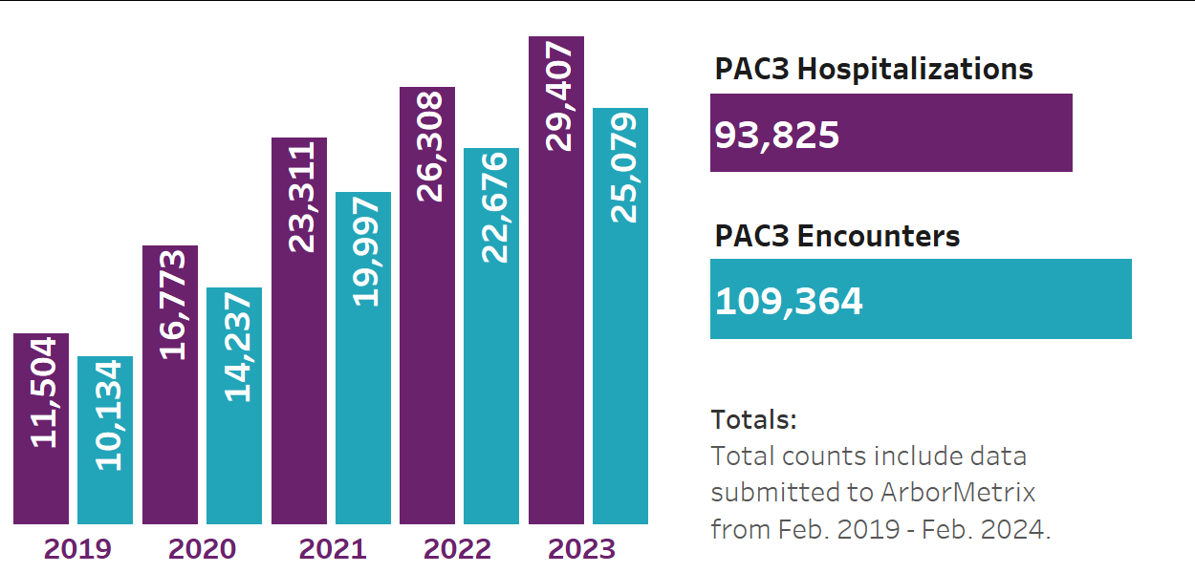
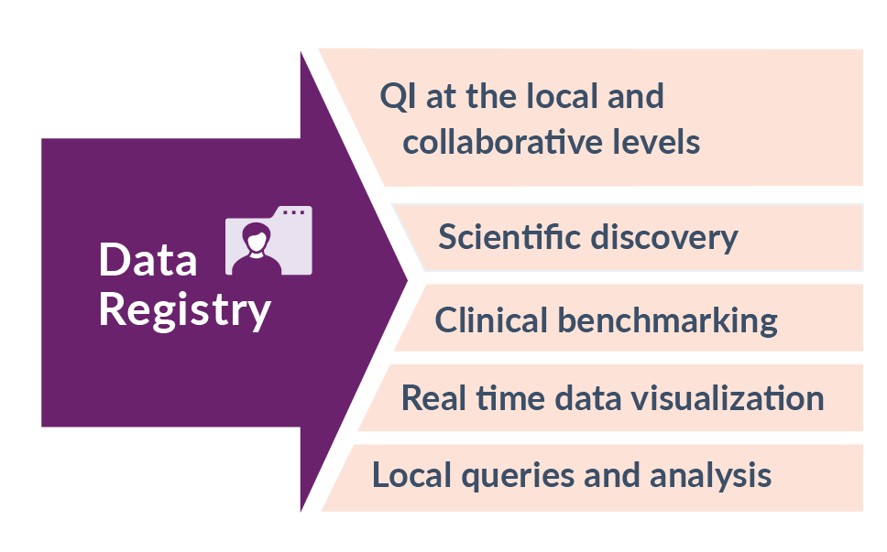
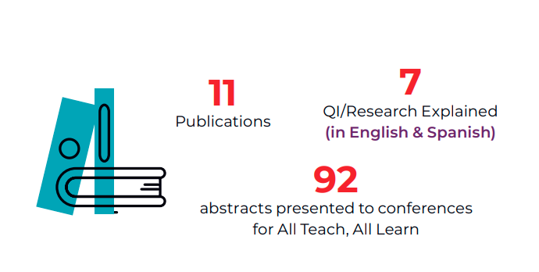
Notes:
2023 – 10, 744 hospitalizations & 12,729 encounters
Total (Feb. 2019 – Sept. 2023): 71,940 hospitalizations & 83,819 encounters
Predicted to break 100,000 in 2024!

Slide 11
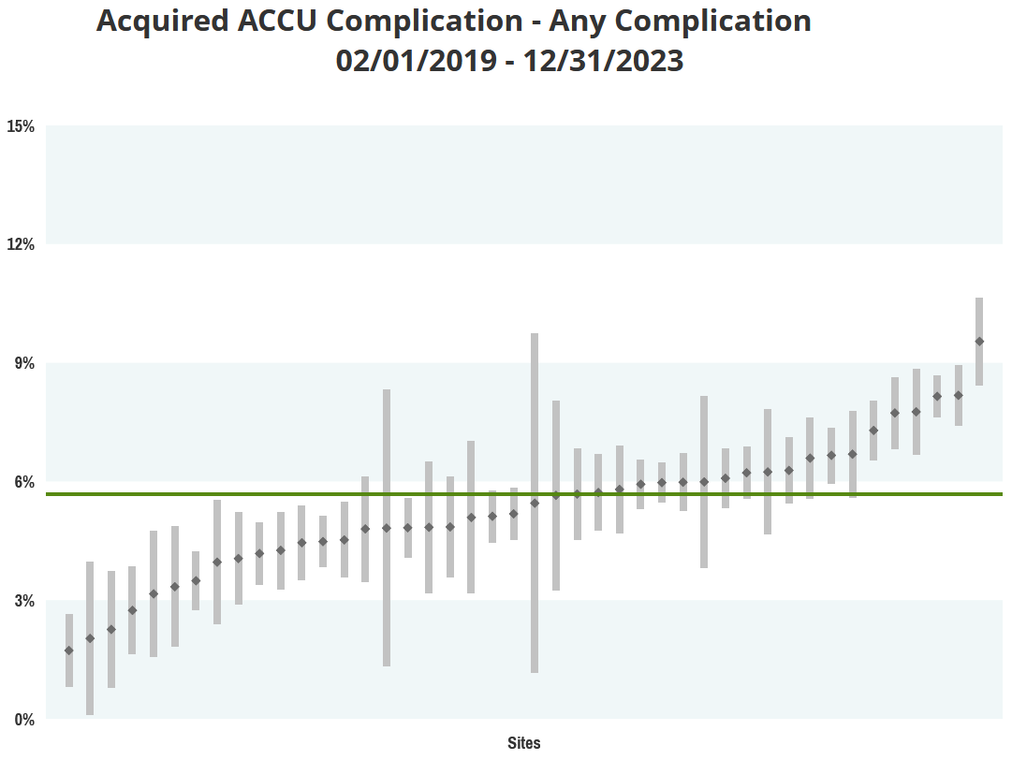
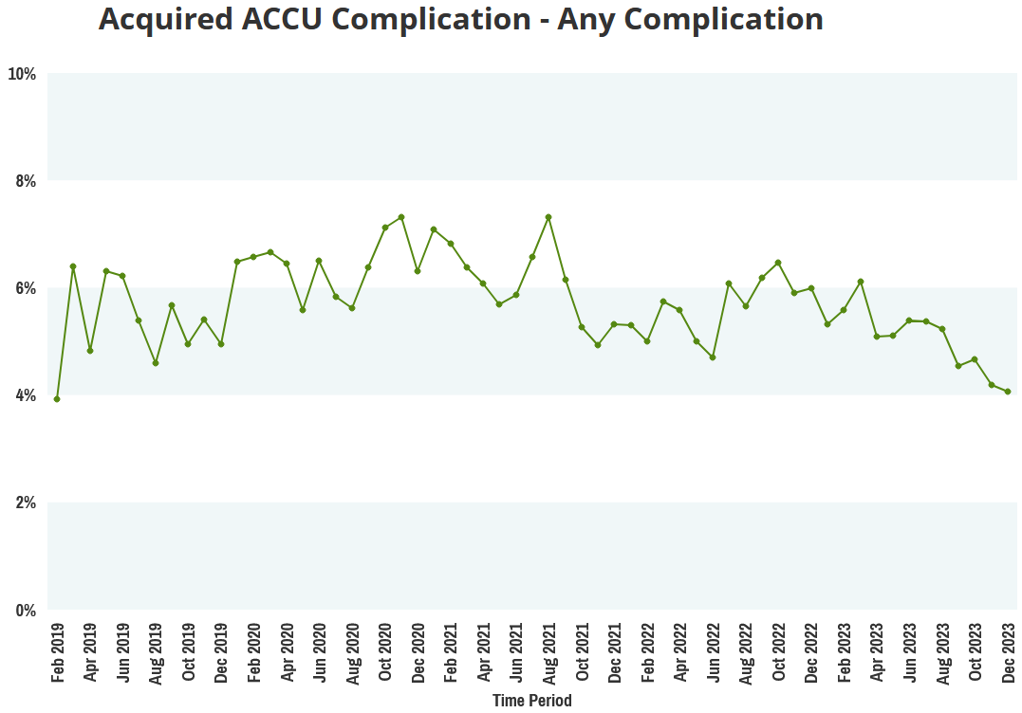
PAC³ Impacts Patient Care through Data
Real time access to data
Compare data on length of stay, resource utilization, therapies, feeding, complications, and other variables with other centers
Clinical Champion unblinded access to hospital data
Compare measures across centers and over time

Slide 12
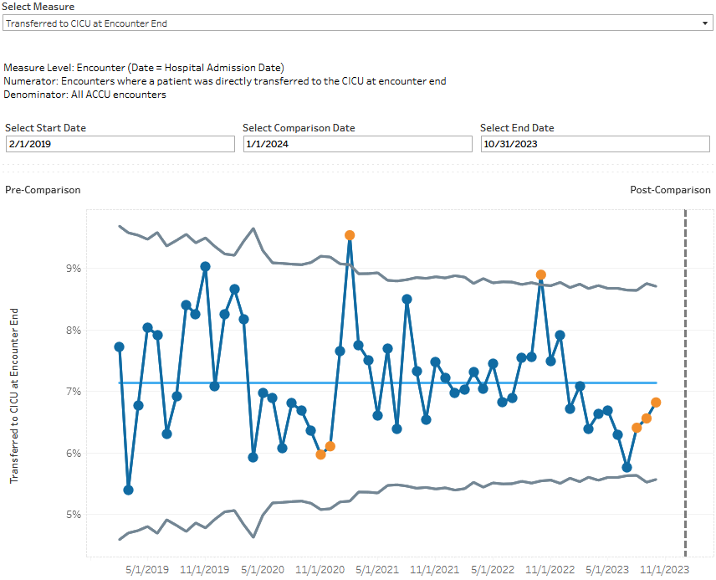
Example Measures available in ArborMetrix
Notes:
Which measure do we want to show? CICU Transfer or Feeding at Enc End?

Slide 13
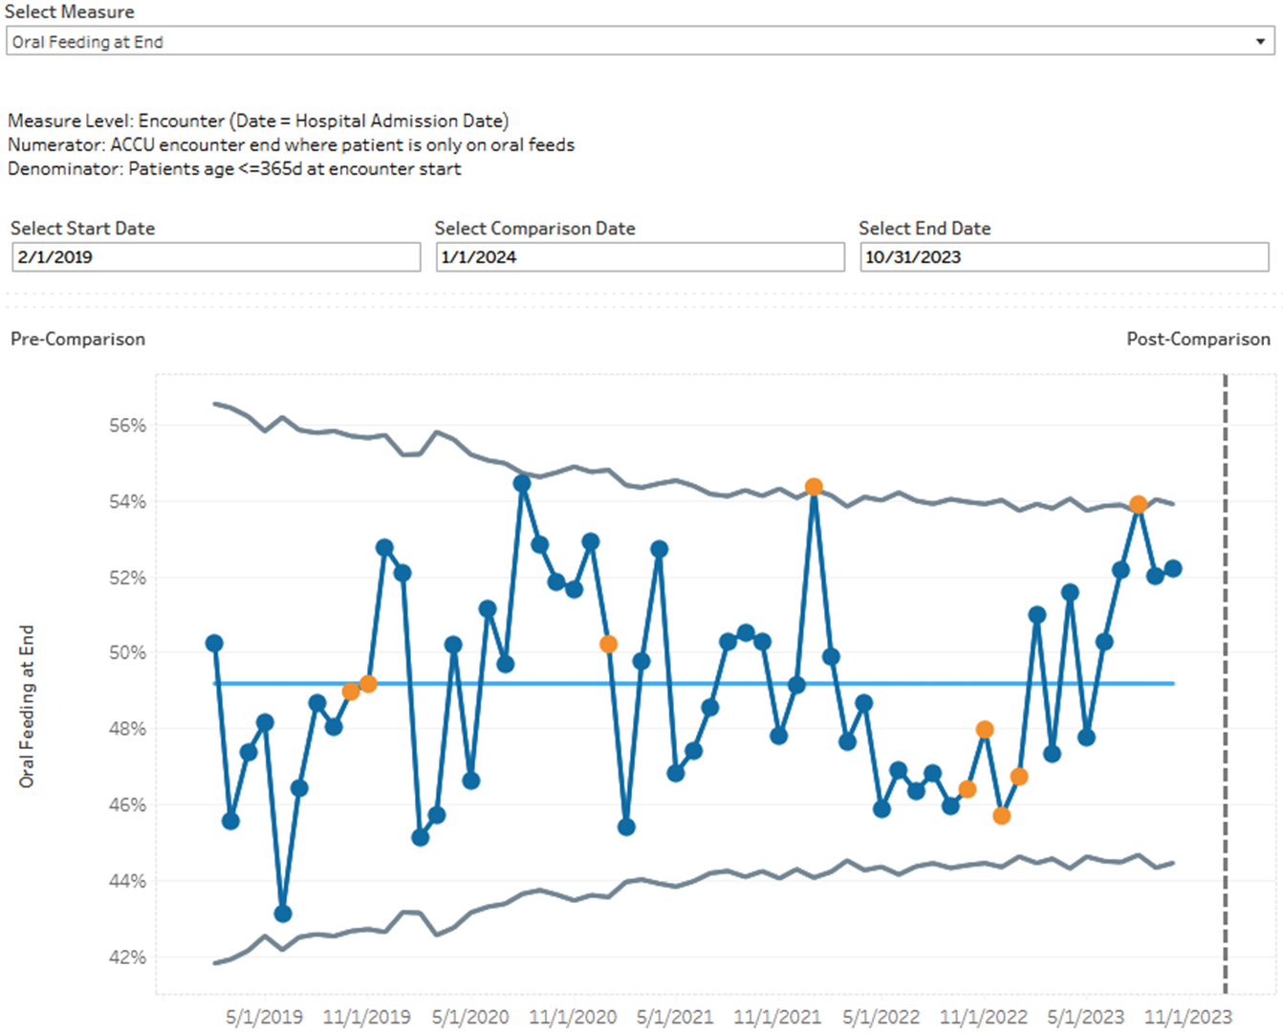
Example Measures available in ArborMetrix

Slide 14
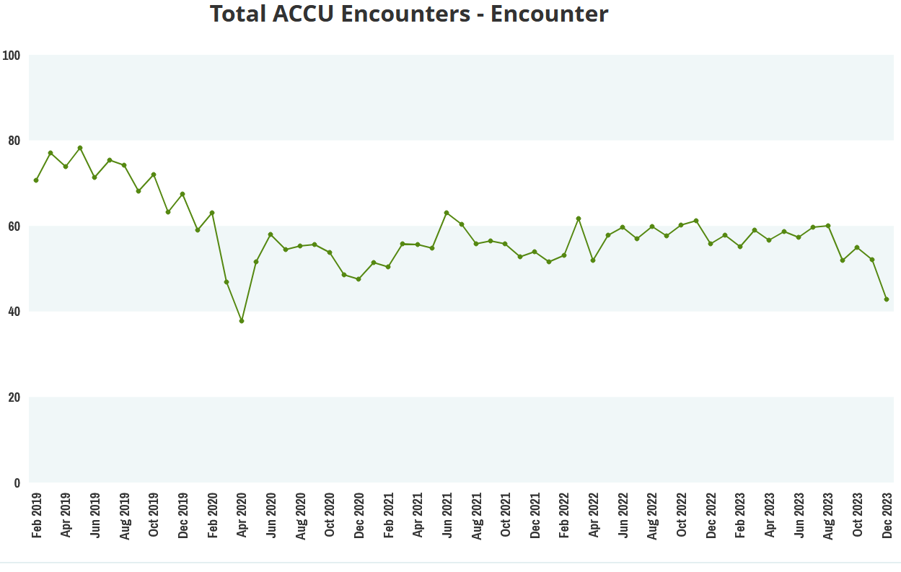
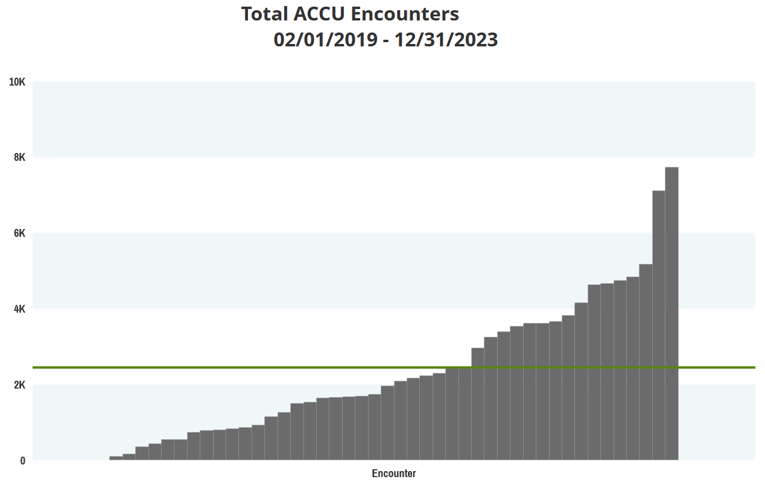
PAC³ Impacts Patient Care through Benchmarking
“Our collaboration with clinical data registries and their reporting platforms allow us to benchmark with other centers in near-real-time. Our center relies heavily on the PC4 and PAC³ reporting platform to track and trend data, and to identify opportunities for improvement. The ease-of-use, especially visualizing the data in run charts and bar charts is extremely valuable.” – PAC³ Member Center
Time Period
Sites

Slide 15
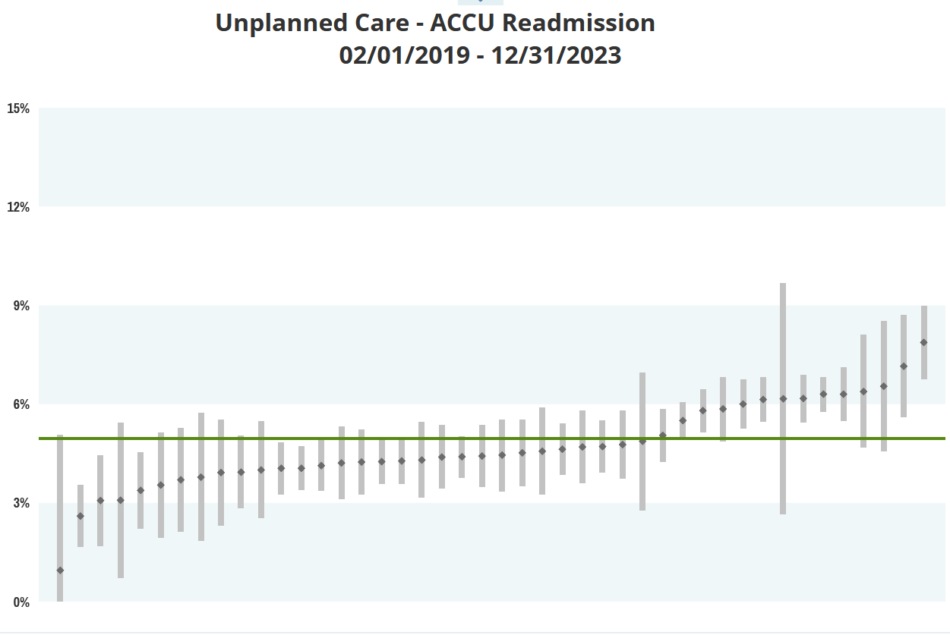
“PAC³ clinical data and benchmarking provided information for us to recognize how our readmission rate compared to other centers to further support our need for improvement in this area. PAC³ data will allow us to dive deeper into our readmissions to identify themes, specific patient populations, and causes which will help us direct our improvement interventions.
Participation in PAC³ collaborative has also provided our center with valuable education and tools to complete quality improvement initiatives that will help as we embark on reducing readmissions on our acute care floor.”
–PAC³ Member Center
Sites

Slide 16
PAC³ Supports Actionable Registry Data
Timely, accurate data is essential for use in local clinical and quality work as well as for collaborative research projects
Rigorous, four-tiered auditing process for all centers within 1 year after data entry start
The cost of data collection is the most significant of membership; PAC³ has invested resources aimed at improving systems around data collection to maximize efficiency
NOTE: Centers with a 1.0 FTE dedicated to data collection for every 800 inpatient encounters/year were most successful in achieving timely, accurate data reporting.

Slide 17
Four-tiered Audit Framework
local site and dcc audit
regional audit
Review PC4 audit status
Ensure all cases are submitted
Reliability of cases
Validity
Confirm that site has passed a PC4 Audit
PAC³-only centers: 1st audit will be individual
Send census data to DCC for comparison with cases entered into PAC³ registry
Data Manager to reconcile census with submitted data
Internal review of cases
Centers report on internal reliability auditing quarterly
Ensure data is entered accurately
Takes place in-person or virtually
Data manager calculates scoring
Notes:
Sue present

Slide 18
PAC³ Supports Actionable Registry Data
A collaborative-wide quality improvement project focused on data entry efficiency was launched in 2020
By 2022 (despite COVID) the percentage of cases submitted within 1 month of discharge +7 days from 55% to 71%
Notes:
Amy maybe… update (review data and see if we have sustained timeliness??)
Amy: I need to put this in the correct template.
Should we evaluate where we are with timeliness

Slide 19
PAC³ Resources for Data Entry
The Getting Started Toolkit is available online and on SharePoint
Includes sections on:
Expectations for the clinical champion, data champion & data team
Building a patient identification report
Chart abstraction for challenging fields
Tracking patients
Process for internal review of cases
Maximizing partnerships with clinical teams
Mentor Hospital Support

Slide 20
Our Commitment
Our new Health Equity module captures:
Language spoken
Insurance type
Utilizes the DeGAUSS tool* to determine:
Neighborhood Deprivation index, including fraction poverty, median income, fraction high school education, fraction no health insurance, households with assisted income in the last 12 months, fraction vacant housing
Distance from patient residence to hospital
*https://degauss.org/index.html

Slide 21
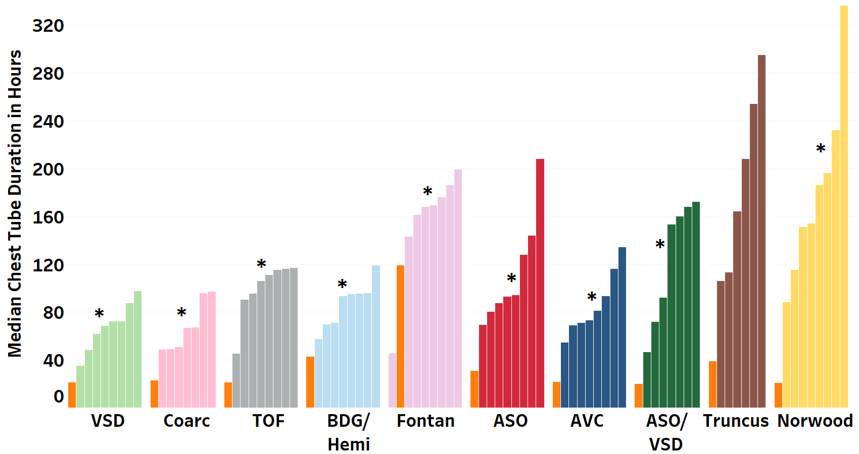
PAC³ Impacts Care through Quality Improvement
Chest tube duration reduction after cardiothoracic surgery
Identified a model site and learned from it
Pioneer cohort successfully decreased chest tube duration
Spread to an additional 9 sites
Developing a change package to allow all other centers to take on this project
Model site
*p<0.05 across sites

Slide 22
Data from the Chest Tube Duration Reduction QI project
Centers in the pioneer cohort reduced chest tube duration by 24% reduced length of stay from a mean of 11.4 days to 10.4 days in 2V STS benchmark surgeries
Notes:
Team - Add a line about where we are now?? Or add manuscript figure?
Can we use the 2022 fall conference slide?

Slide 23
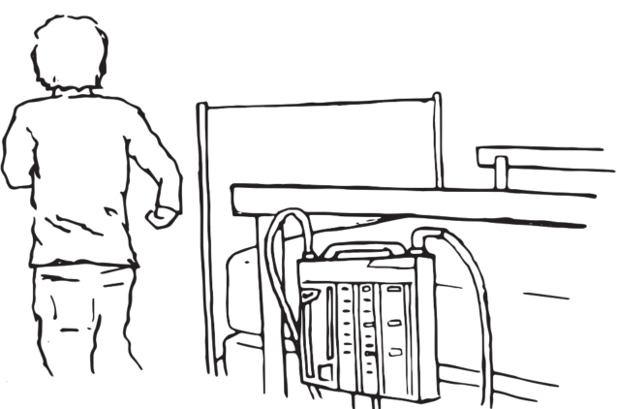
Quotes from Families on the Chest Tube Project
”We could tell it was so uncomfortable which meant he had to get pain meds consistently to alleviate the pain. The second the chest tube came out there was an instant change in our son’s behavior, and you could tell he was more comfortable. Short chest tube durations mean less time being uncomfortable, less time getting pain meds, a faster recovery process and hopefully shorter hospital stay.”
–Sameer, Dad of Dev
Getting them out was one step closer to my being able to hold him so I was glad to see them go!
–Corey, Mom of Noah
“Going forward, having a shorter chest tube duration means that there is the possibility that families of kids who have heart surgery can get back to their “normal” lives, which is always a good thing.”
–Mariel, Mom of Eli

Slide 26
Opportunities for Providers and Member Centers

Slide 27
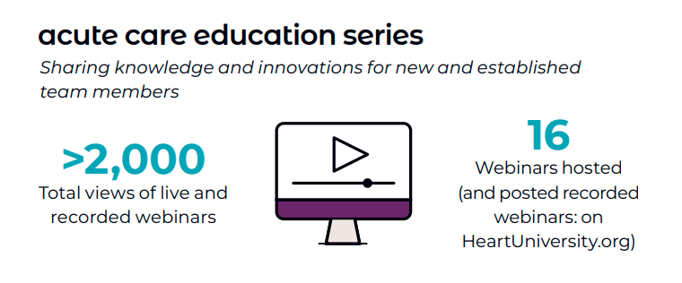
Educational Opportunities Provided by PAC³
Quarterly Acute Care Cardiology Grand Rounds
See past recorded webinar talks at: pac3quality.org/education-series
Quality Improvement education
On collaborative QI project webinars
Institute for Healthcare Improvement (IHI) Open School licenses*
Quality improvement education course
APP orientation curriculum
*provided by Cardiac Networks United

Slide 28
"Talking is Teaching: Talk, Read, Sing" is a public awareness and action campaign that helps parents recognize their power to boost their children’s early brain & vocabulary development through simple, everyday actions.
PAC³ is proud to sponsor these initiatives for families while they are on the ACCU.
Talking is Teaching Program

Slide 29
Leadership Opportunities for All Levels of Provider
Opportunities to present at national conferences and in educational series
Authorship on publications
Committee membership and leadership roles
Project leads

Slide 30
Resources Needed

Slide 31
Resources & Contracting
PAC³ Membership: Signed Letter of Intent
Executed Data Use Agreement (DUA) with University of Michigan
Execution of multiple module financial amendment not required for data entry, but required for a clinical champion to have access to ArborMetrix data that is unblinded by site
Executed Master Subscription Agreement (that includes a Business Associate Agreement) with ArborMetrix Inc
If already a member of PC4 or CNOC, adding the PAC3 module via an amendment to the original agreement (Joinder Agreement)
Contract in place with CardioAccess or LUMEDX for PAC³ module
IRB exemption/approval needed
Previous institutional IRB approval for PC⁴ serves as approval for PAC³ in most cases (check with your local IRB)
Data Entry Personnel – data entry and travel for meetings
Most successful sites in terms of data accuracy and timeliness have 1FTE per 800 acute care unit encounters/year

Slide 32
Resources Needed
ArborMetrix (annual cost)
$12,500 for one registry (PAC³ or PC⁴)
$17,500 for both (PAC³ and PC⁴)
LUMEDX and CardioAccess
Prefer to quote sites individually
One time set up fee estimated to be $10–15K
Annual maintenance fee estimated to be $3–6K
PAC³ fee
$6,500

Slide 33
Contacts
Website: pac3quality.org
Additional questions or support:
Cortney Higbee, PAC³ Program Director – Cortney.higbee@childrens.com
General inquiries: pac3@childrens.com

